Slide 1
Data Analytics Task 3 Data Visualization Presented By Victor Chukwuma Nwabufo STUDENT ID: CA/SE1/12728

Slide 2
# Import Libraries
import pandas as pd
import numpy as np
import matplotlib.pyplot as plt
import seaborn as sns
# Make plots visually appealing
sns.set(style="whitegrid")
plt.rcParams["figure.figsize"] = (8, 6)
# Load Dataset
# Upload your Excel file from Colab sidebar or Google Drive
from google.colab import drive
drive.mount('/content/drive')
df = pd.read_excel("/content/drive/MyDrive/CodeAlpha/Sample-Superstore.xls")
# Preview the dataset
df.head()

Slide 3
# Check column names
print("\nColumn names:\n", df.columns
# Explore and Clean the Data
# Check structure
df.info()
# Check for missing values
print("\nMissing values per column:\n", df.isnull().sum())
# Drop duplicates
df.drop_duplicates(inplace=True)
# Drop missing values (if any)
df.dropna(inplace=True)
# Verify dataset shape
print("\nDataset Shape after cleaning:", df.shape)
)

Slide 4
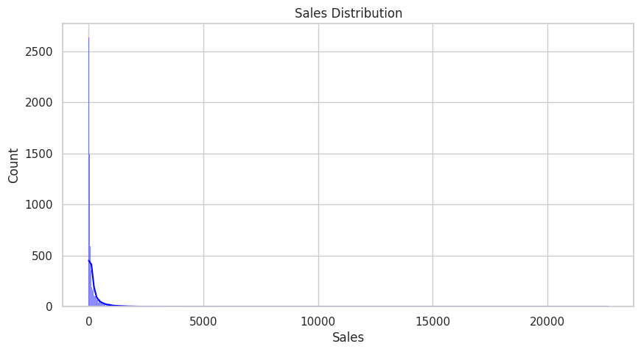
# Basic Statistical Summary
df.describe()
# Sales and Profit Distribution
df(['Sales', 'Profit']).describe
plt.figure(figsize=(10,5))
sns.histplot(df['Sales'], kde=True, color='blue')
plt.title('Sales Distribution')
plt.show()

Slide 5
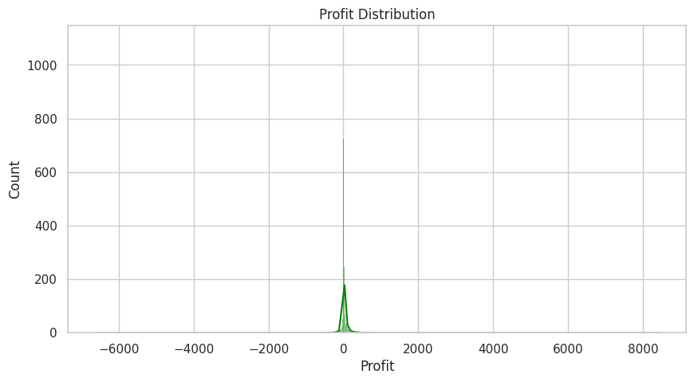
plt.figure(figsize=(10,5))
sns.histplot(df['Profit'], kde=True, color='green')
plt.title('Profit Distribution')
plt.show()
print('Sales are positively skewed — most transactions are small, few are large.’)
Sales are positively skewed — most transactions are small, few are large.

Slide 6
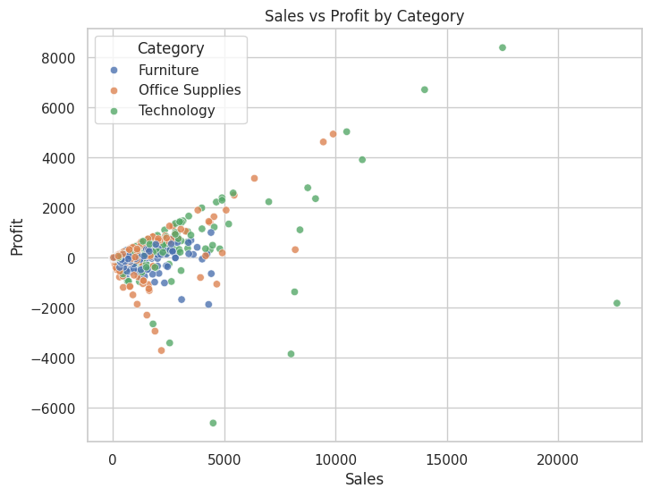
# Relationship: Sales vs Profit
plt.figure(figsize=(8,6))
sns.scatterplot(data=df, x='Sales', y='Profit', hue='Category', alpha=0.8)
plt.title("Sales vs Profit by Category")
plt.show()
print('Some high sales bring negative profit — possibly due to excessive discounts.')
Some high sales bring negative profit — possibly due to excessive discounts.

Slide 7
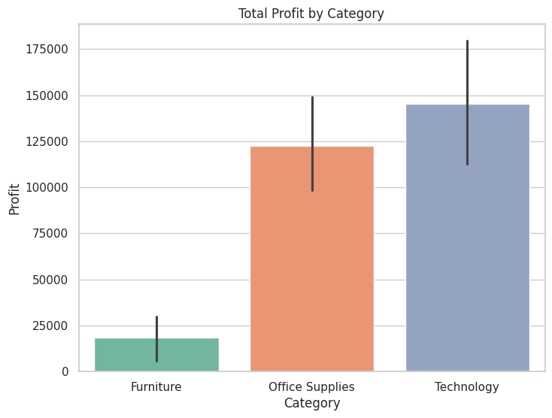
#Profit by Category
plt.figure(figsize=(8,6))
sns.barplot(data=df, x='Category', y='Profit', estimator=sum, palette='Set2')
plt.title("Total Profit by Category")
plt.show()
print("Technology is the most profitable category; Furniture often lags behind.")
Technology is the most profitable category Furniture often lags-behind.

Slide 8
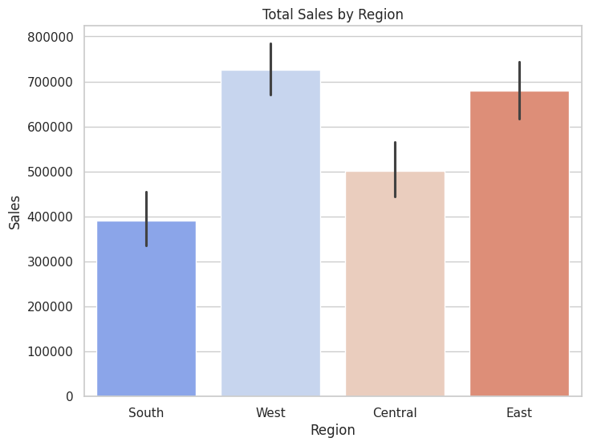
#Sales by Region
plt.figure(figsize=(8,6))
sns.barplot(data=df, x='Region', y='Sales', estimator=sum, palette='coolwarm')
plt.title("Total Sales by Region")
plt.show()
print("Western and Eastern regions dominate sales.")
Western and Eastern regions dominate sales.

Slide 9
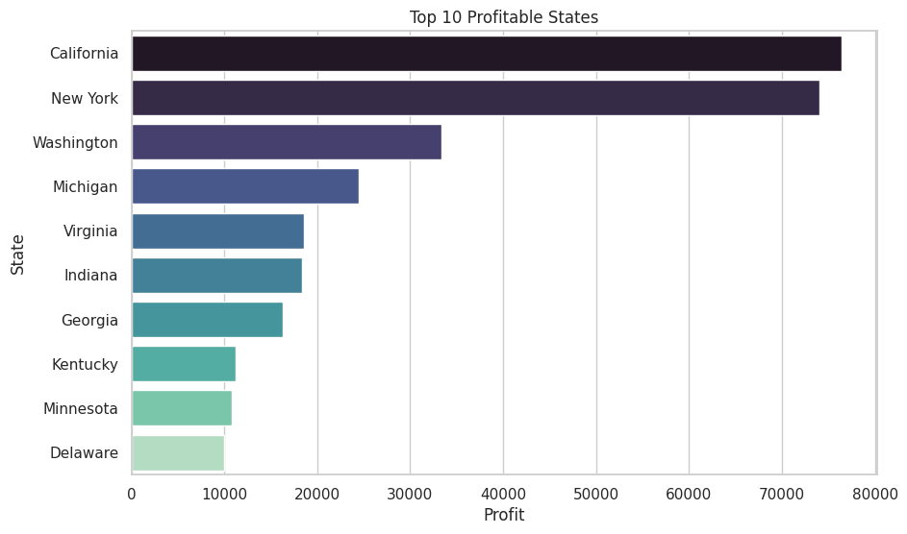
# Top 10 Profitable States
top_states = df.groupby('State')['Profit'].sum().sort_values(ascending=False).head(10)
plt.figure(figsize=(10,6))
sns.barplot(x=top_states.values, y=top_states.index, palette="mako")
plt.title("Top 10 Profitable States")
plt.xlabel("Profit")
plt.ylabel("State")
plt.show()
print("California and New York are the most profitable states.")
California and New York are the most profitable states.

Slide 10
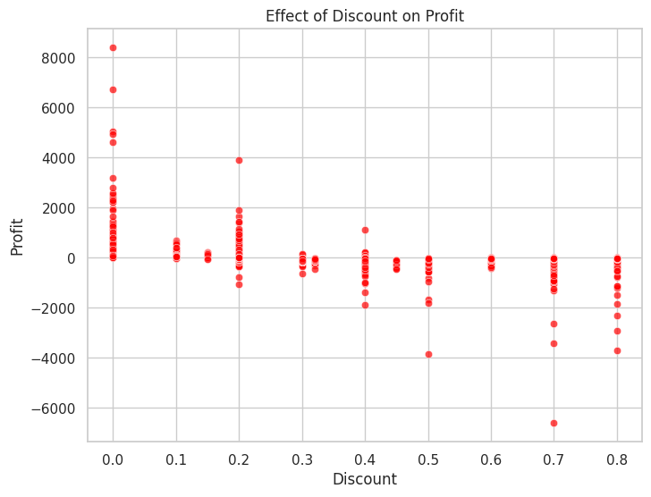
#Impact of Discount on Profit
plt.figure(figsize=(8,6))
sns.scatterplot(data=df, x='Discount', y='Profit', alpha=0.7, color='red')
plt.title("Effect of Discount on Profit")
plt.show()
print("Higher discounts have a negative impact on profit.")
Higher discounts have a negative impact on profit.

Slide 11
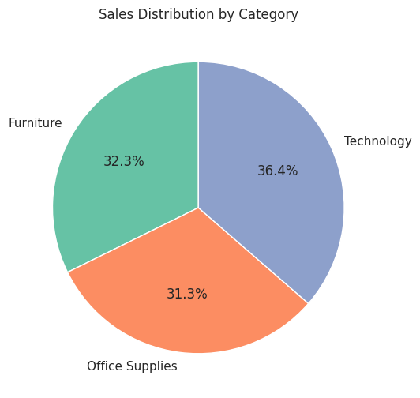
#Sales Share by Category (Pie Chart)
sales_by_category = df.groupby('Category')['Sales'].sum()
plt.figure(figsize=(6,6))
plt.pie(sales_by_category, labels=sales_by_category.index, autopct='%1.1f%%', startangle=90, colors=sns.color_palette('Set2'))
plt.title("Sales Distribution by Category")
plt.show()
print("Technology dominate sales.")
Technology dominate sales.

Slide 12
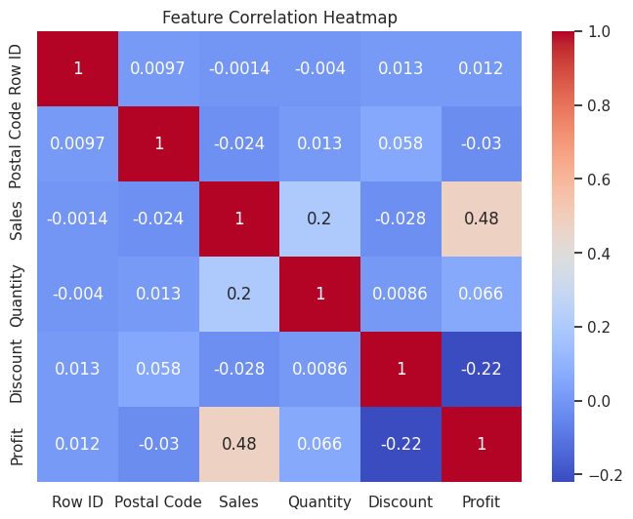
#Correlation Heatmap
plt.figure(figsize=(8,6))
sns.heatmap(df.corr(numeric_only=True), annot=True, cmap="coolwarm")
plt.title("Feature Correlation Heatmap")
plt.show()
print("Sales and Profit are moderately correlated; Discount is negatively correlated with Profit.")
Sales and Profit are moderately correlated; Discount is negatively correlated with Profit.

Slide 13
# Multi-Chart Dashboard fig, axes = plt.subplots(2, 2, figsize=(14,10))
sns.barplot(data=df, x='Category', y='Profit', estimator=sum, ax=axes[0,0],palette='coolwarm')
axes[0,0].set_title("Profit by Category")
sns.barplot(data=df, x='Region', y='Sales', estimator=sum, ax=axes[0,1],palette='coolwarm')
axes[0,1].set_title("Sales by Region")
sns.scatterplot(data=df, x='Discount', y='Profit', ax=axes[1,0],color='red')
axes[1,0].set_title("Discount vs Profit")
sns.heatmap(df.corr(numeric_only=True), annot=True, cmap="coolwarm", ax=axes[1,1])
axes[1,1].set_title("Correlation Heatmap")
plt.tight_layout()
plt.show()
print("This dashboard view summarizes key business patterns at once.")

Slide 14
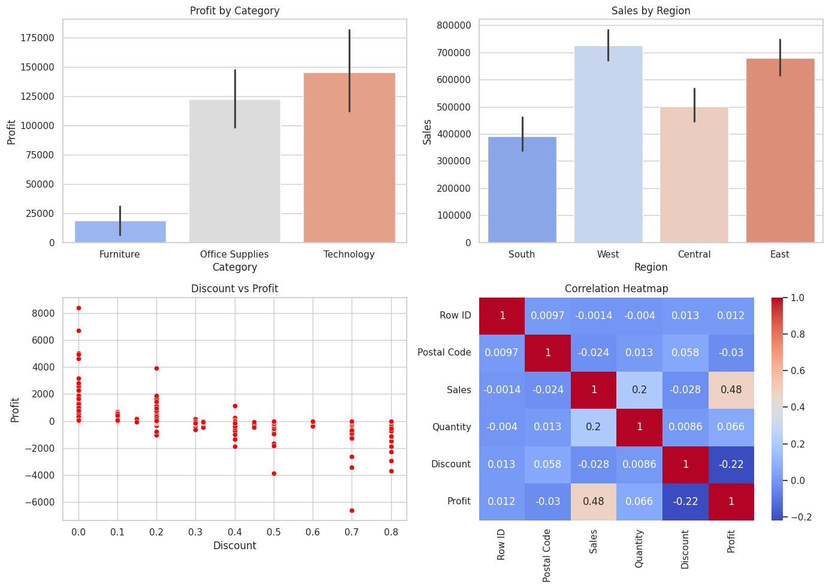
This dashboard view summarizes key business patterns at once.

Slide 15
# Data Storytelling
print('The Dataset Analysis shows that:')
print('\n1.The Technology category generates the most profit.')
print('\n2.The Furniture category has several loss-making transactions.')
print('\n3.High discounts significantly reduce profit margins.')
print('\n4.The West and East regions lead in sales, with California and New York as top-performing states.')
print('\n5.To improve profitability, discount rates should be optimized, and focus should shift to underperforming categories and regions.')
The Dataset Analysis shows that: 1.The Technology category generates the most profit. 2.The Furniture category has several loss-making transactions. 3.High discounts significantly reduce profit margins. 4.The West and East regions lead in sales, with California and New York as top-performing states. 5.To improve profitability, discount rates should be optimized, and focus should shift to underperforming categories and regions.

Slide 16
Key
# Key Findings
1
print('\n Key Findings: ')
2
print('\n* Heavy discounts reduce profit')
3
print('\n* Technology is the best-performing category')
4
print('\n* Western region dominates sales and profitability')
5
print('\n* Central and South regions need targeted strategies')
Key Findings:
Heavy discounts reduce profit
Technology is the best-performing category
Western region dominates sales and profitability
Central and South regions need targeted strategies

Slide 17
Tableau Worksheets, Dashboard and Story Screenshots

Slide 18
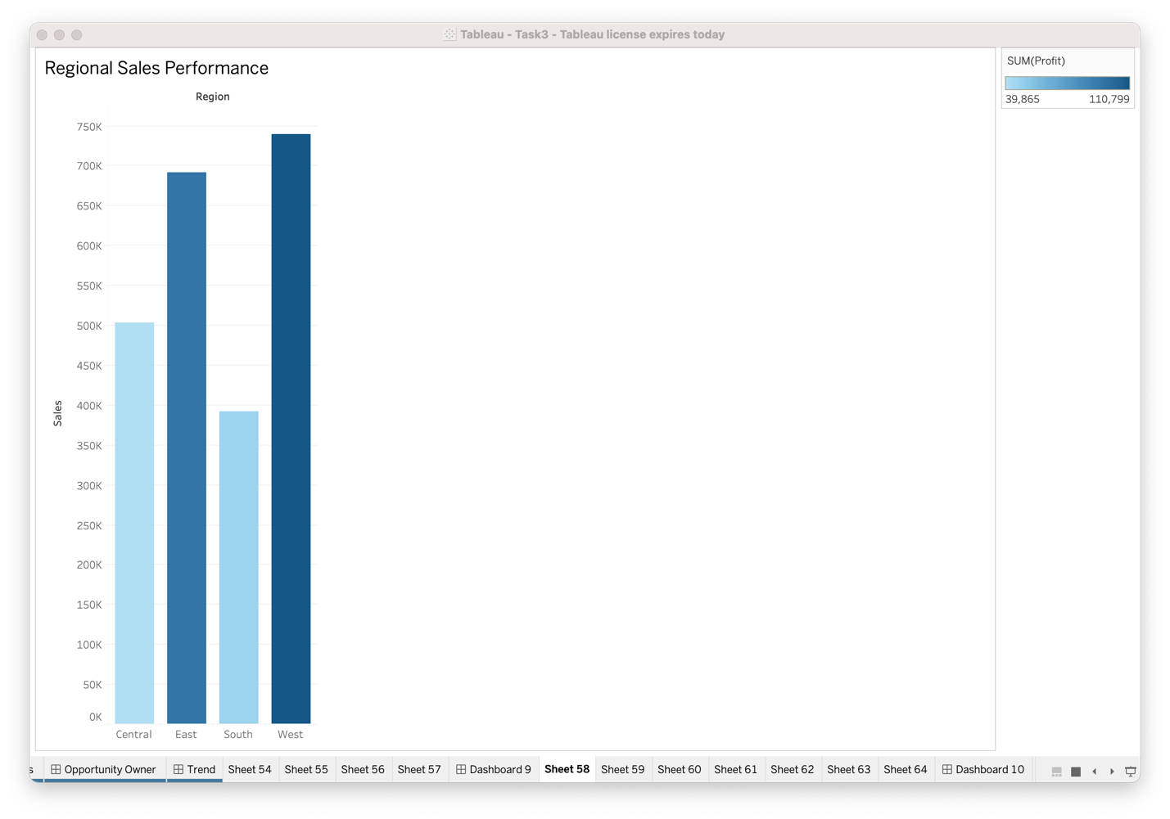

Slide 19
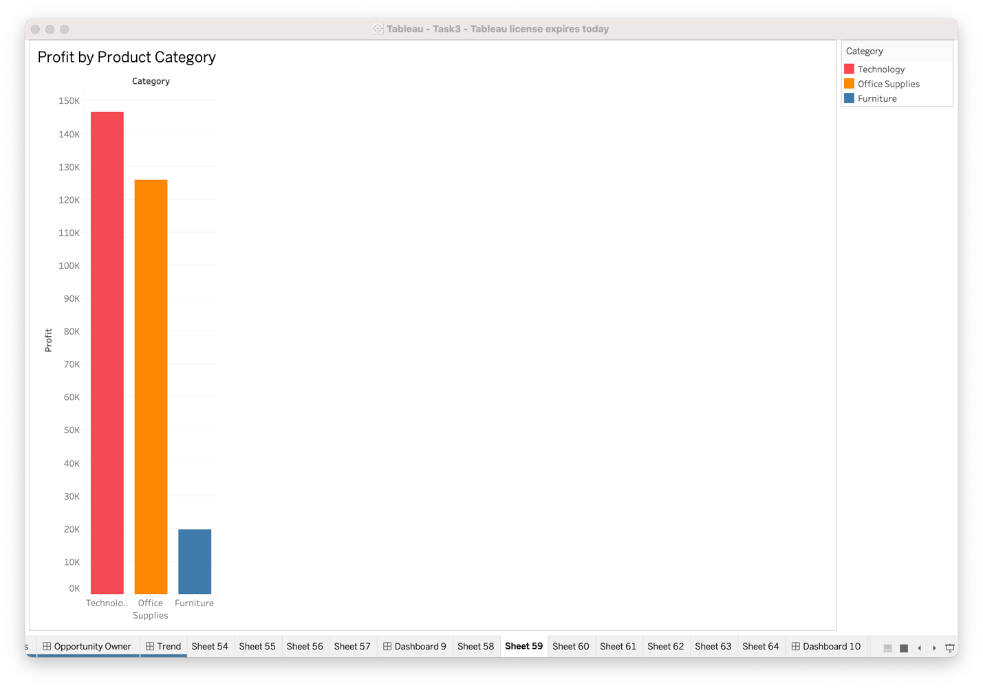

Slide 20
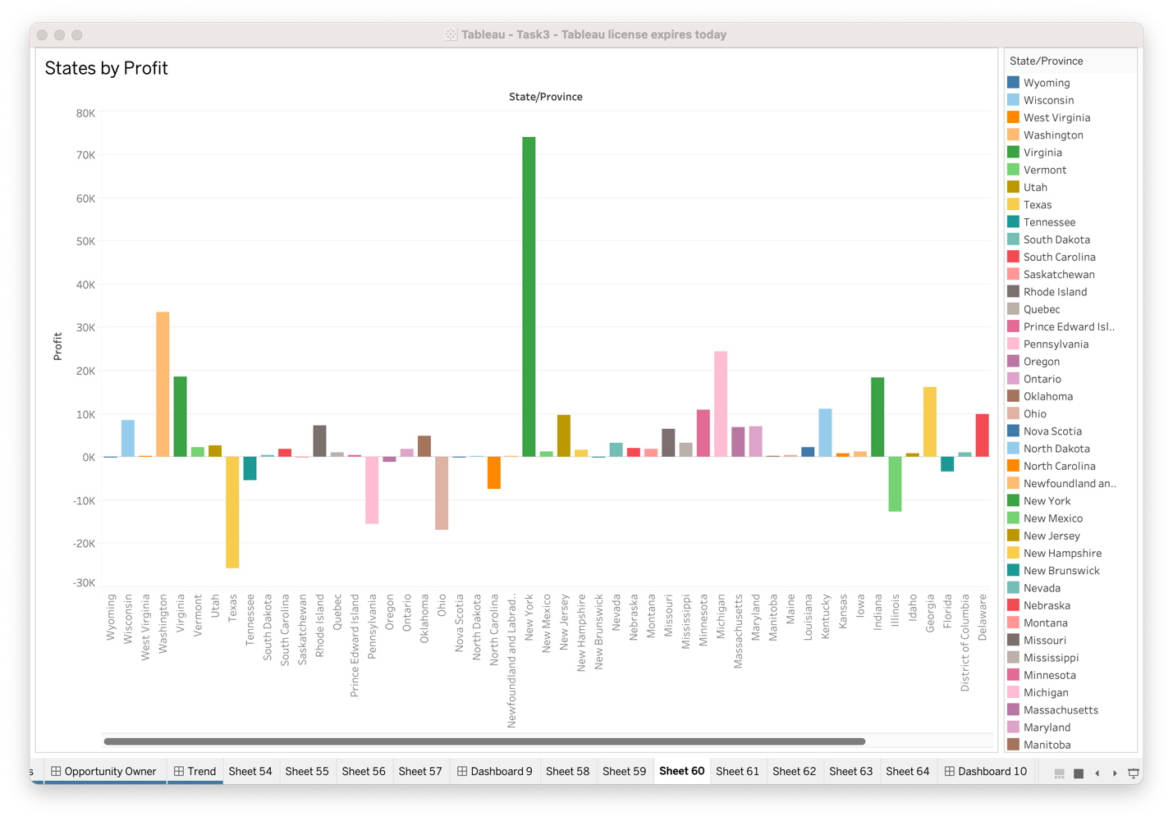

Slide 21
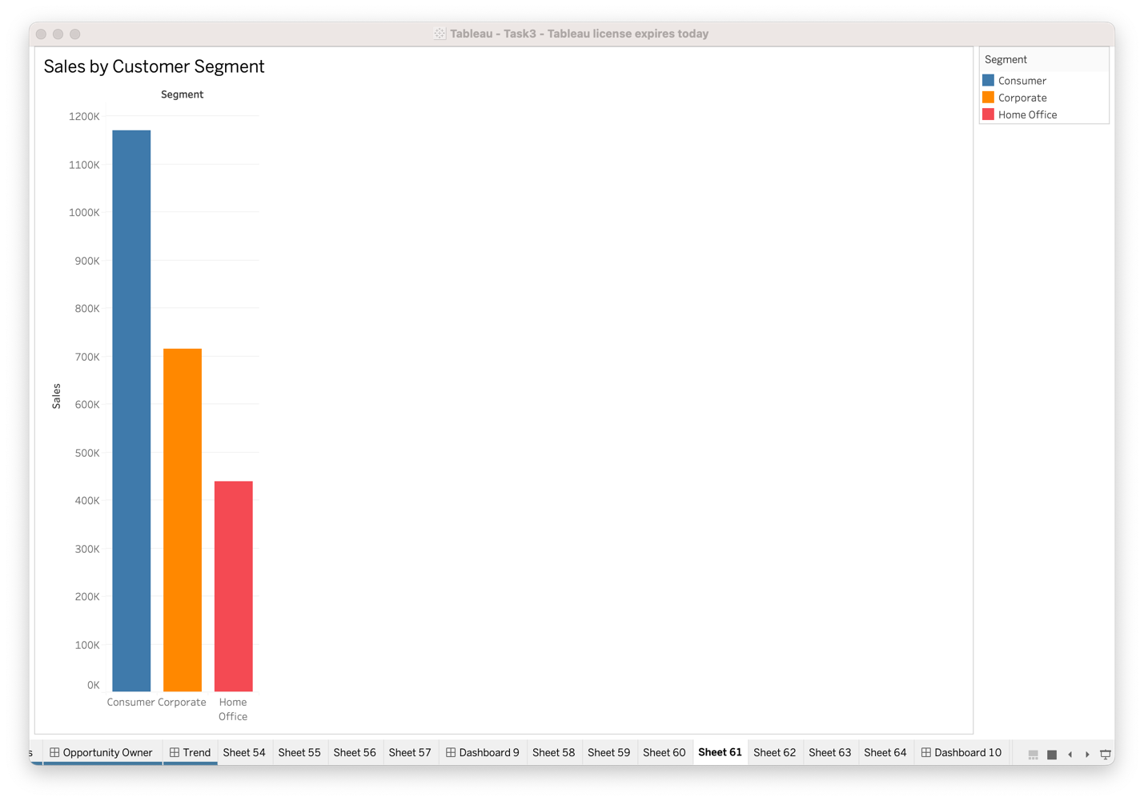

Slide 22
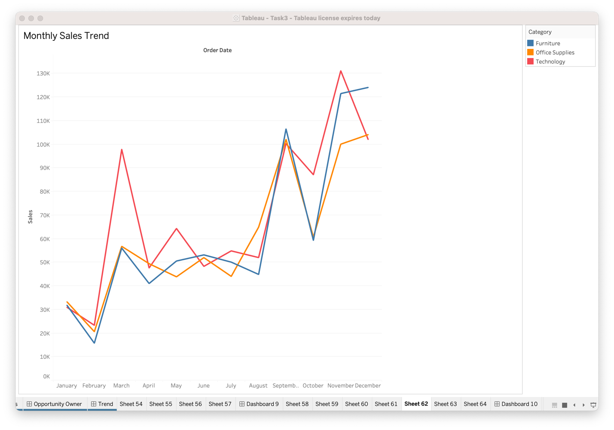

Slide 23
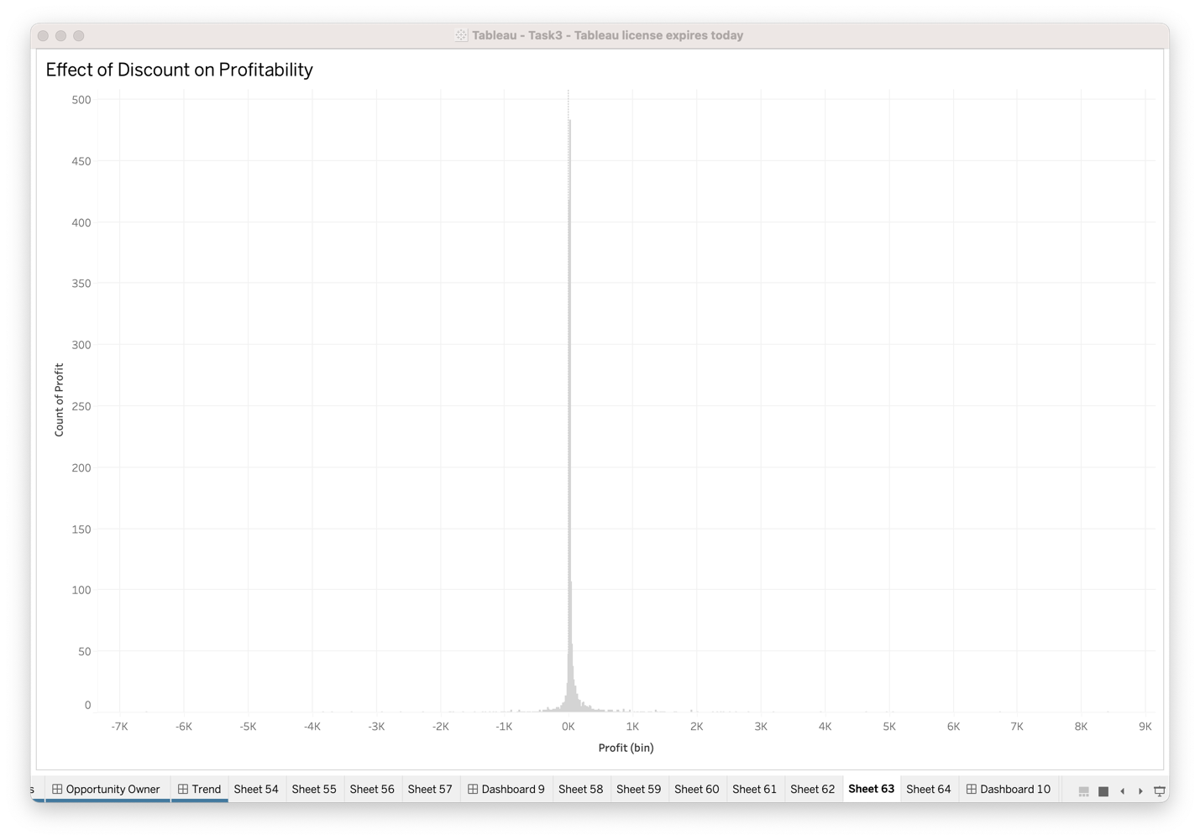

Slide 24
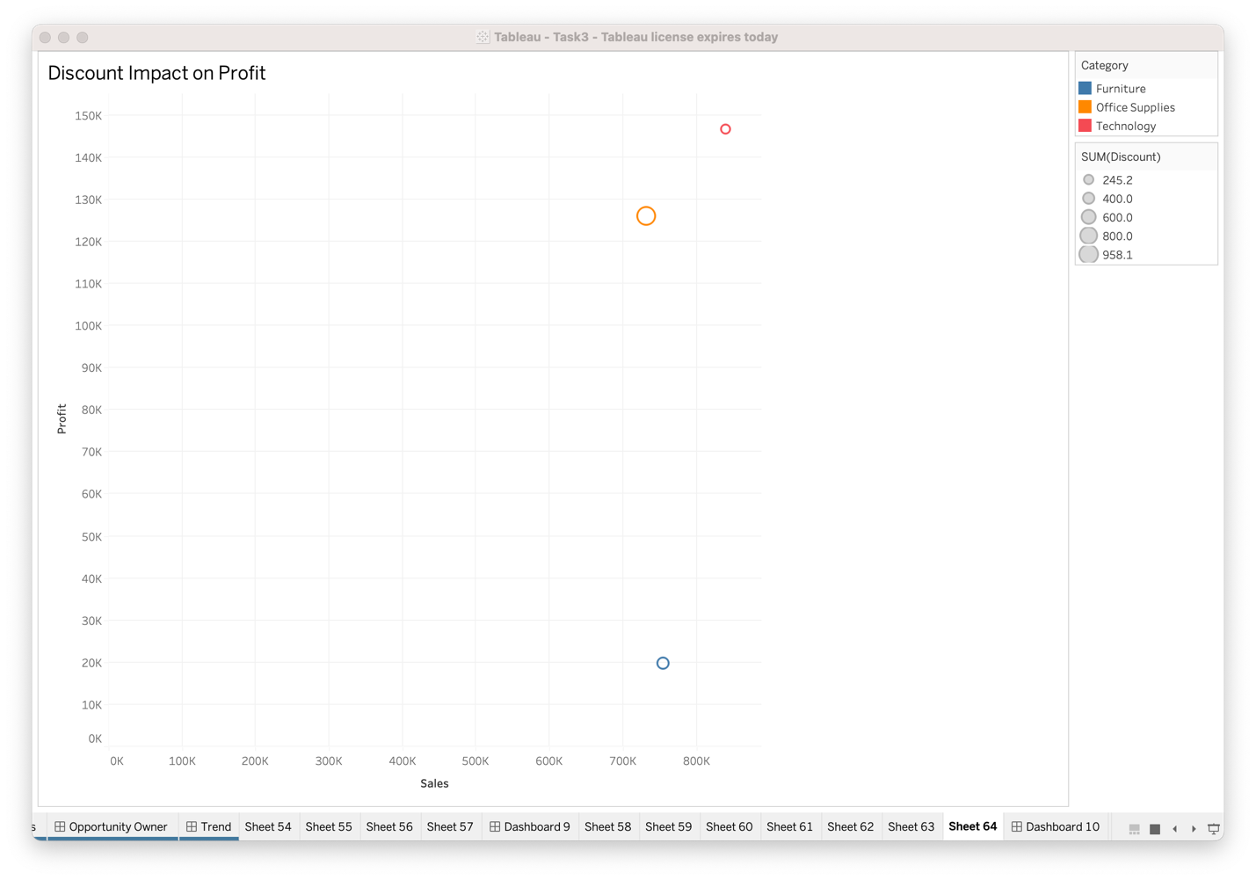

Slide 25
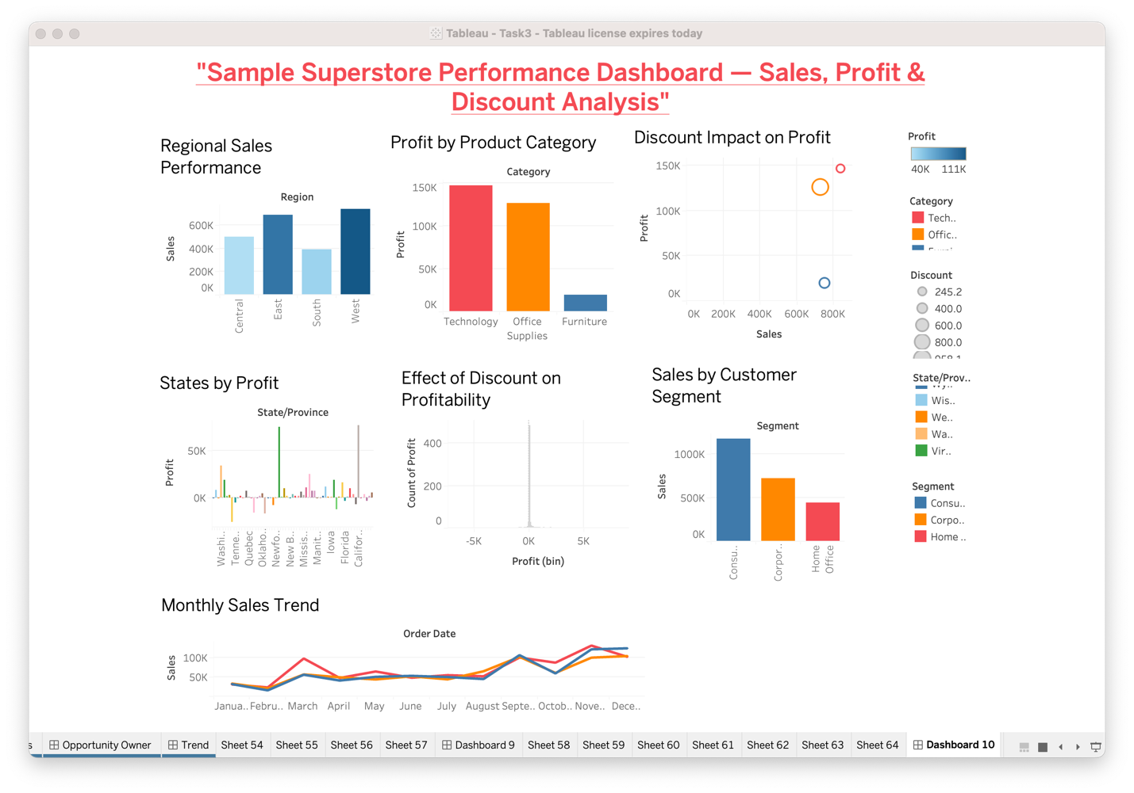

Slide 26


Slide 28
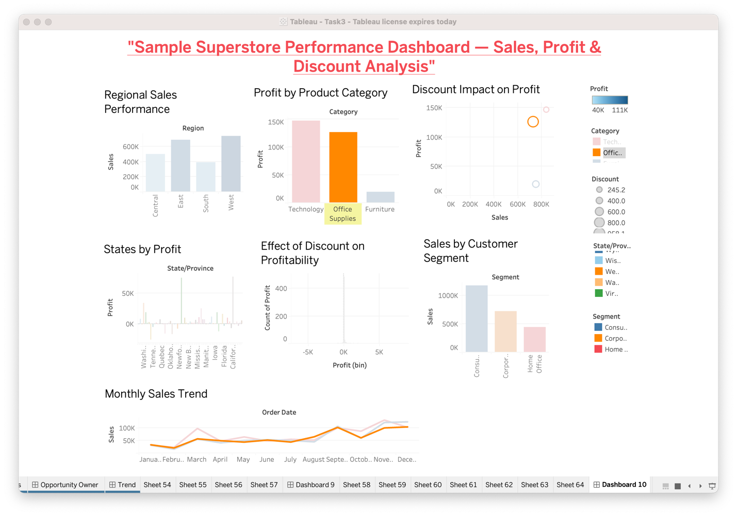

Slide 29
